Slide 1
Course - DT228/1 and DT282/1
Subject - Computer Architecture and Technology
COMPUTING AND ITS HISTORY
Semester 2, Week 2

Slide 2
The Topics
What is a computer again?
Architecture Fundamentals - Introduction and History: from Babbage to multi-core processors
We should look at computers and their history first… get to the architecture fundamentals later.

Slide 3
Computer…?
A computer is a device – usually an electronic device - that accepts information in the form of data and manipulates them for some result which is often output.
The manipulation is a process or method based on a computer program or sequence of instructions on how the data are to be processed.

Slide 4
Computer!
Many computers also include the means for storing data and programs for a necessary period of time. Time that could be a nanosecond or a millennium.

Slide 5
Computer System
What is a ‘system’?
A system is a generally defining word that implies that there exists a type of input, a type of procedure and a type of output.

Slide 6
Computer System (2)
A computer system can be described as having
input(s),
procedure(s) or process(es),
output(s).

Slide 7
Computer System (3)
INPUT ------→ PROCESS -----→ OUTPUT
A computer system is a set of hardware and software that processes data.
A relatively simple computer system is a personal computer. An example of a complex computer system is the Internet.

Slide 8
Computer System (4)
What makes a computer system even more useful is its ability to STORE data (or signals of a non-data type) after they have been output – or while data are output.
That output or stored data can be used as input in a ‘feedback loop’, if necessary.
8
Notes:
8

Slide 9
Computer System (5)
A computer system is a system because the two aspects of hardware and software have to work together.
A typical ‘computer system’ comes with interconnection capability. (Many computer systems can interconnect - that is, join to become a bigger system.)

Slide 10
Hardware of a Computer System
‘Hardware’ is the term that encapsulates the electronic devices and circuitry that make up the physical components of the computer system.
These elements are the computer parts that you can see and touch.

Slide 11
Hardware of a Computer System (2)
Examples of physical elements – (Hardware):
Central Processing Unit (CPU),
Primary storage,
Secondary storage,
Input devices,
Output devices and
Communications devices

Slide 12
Software of a Computer System
‘Software’ is the term that describes the instructions (and data) that determine the use of the processing capability.
Software is often the invisible means of process that goes on as the computer is running.

Slide 13
Software of a Computer System (2)
Examples of non-physical elements – (Software):
Systems software and/or Operating Systems (O/S),
Applications software,
Database Management Systems (DBMS). (Optional for most computer systems.)
Communications software (when connected to a network).

Slide 14
System of Two Things
The two terms, hardware and software together encapsulate a working computer system.
This basic system allows a datum (singular) and data (a collection of datum) to be represented for input, processing and/or output.

Slide 15
System of Two Things (2)
The physical elements are utilised by non-physical elements of instruction and coordination.

Slide 16
History of Hardware
The next big ‘block’ of slides goes back to early devices for calculation, moving through time to very large-scale integrated circuits.
There is a diversion to mention von Neumann architecture (Systems Architecture) midway.

Slide 17
Babbage and Before
There were simple, mechanical devices for calculating numbers – even dated around 1624.
Wilhelm Schickard lived from 1592 to 1635 was a Christian minister and a Professor of Hebrew, Eastern Languages, Astronomy and Mathematics, among other things, in Tubingen, Germany.

Slide 18
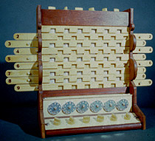
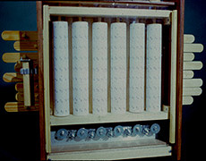
Schickard’s Calculator
Wilhelm Schickard built this adding machine based on his mathematical ideas:
Front
Back

Slide 19
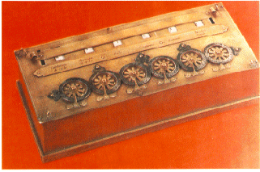
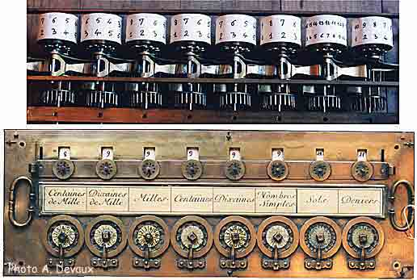
Pascal’s Calculator
Blaise Pascal, the French mathematician, who lived from 1623 to 1662, had an adding and subtracting machine – built around 1642:
Pascal’s Arithmetic Machine

Slide 20
Leibniz’s Calculator
Gottfried Wilhelm von Leibniz lived from 1646 to 1716 and is described as a lawyer, mathematician and a scientist of various other disciplines. His calculator appeared around 1671.
It was another apparatus of cogs and wheels…

Slide 21
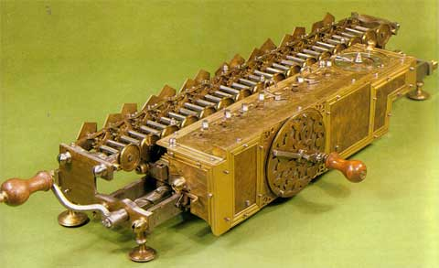
Leibniz’s Calculator (2)
… but it is said to be better than Pascal’s device since it could add, subtract, multiply and divide.
Leibniz’s Calculating Machine

Slide 22
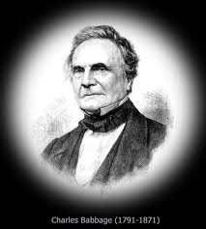
Charles Babbage
Charles Babbage was an English mathematician – but is often seen more of an inventor. He lived from 1791 to 1871.
His mechanical calculator was called the Difference Engine and is said to have been functional in 1822.
The machine was able to generate successive values of algebraic functions by means of finite differences.

Slide 23
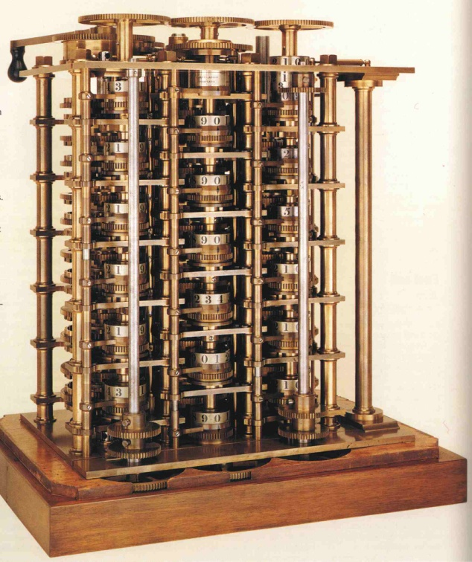
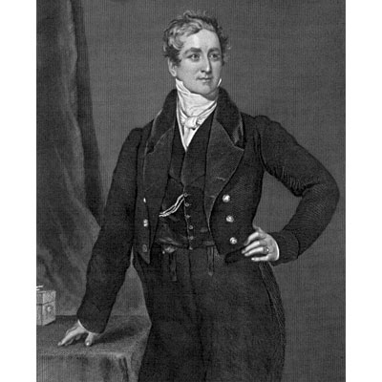

Charles Babbage (2)
The device seems to have worked like a series of Leibniz machines connected together – that is how it seems to me, anyway.
Babbage for scale
Babbage’s Difference Engine

Slide 24
Charles Babbage (3)
After the Difference Engine Babbage set about the Analytical Engine. He did not complete this endeavour, having died, but the idea was to use Jaquard’s Loom technology to manipulate numbers;
Store numbers with a memory consisting of sets of counter wheels
A ‘mill’ as a kind of Arithmetic Logic Unit: a four-function arithmetic unit operating on variables stored on counter wheels and storing the result on a counter wheel
Printer or card punch to output the result
Operation cards to directed the operation to be performed
Variable Cards to call in the variables from the store

Slide 25
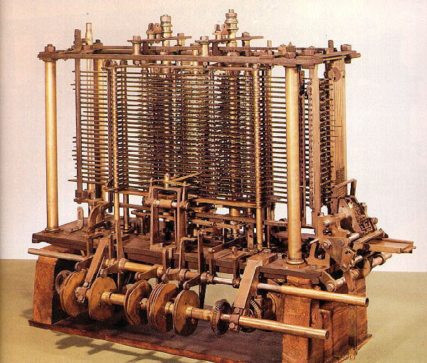
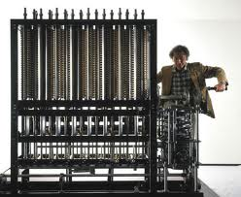
Charles Babbage (4)
What is this? Some Web sites say it is the Analytical Engine in complete form. Historically, it was never properly built… but this may be a fair representation:
For scale
Babbage’s Analytical Engine?

Slide 26
Charles Babbage (5)
The Mill
(Arithmetic
Functions)
The Store
(Memory)
Printer and
Punch Cards
Operation
Cards
Variable
Cards

Slide 27
Hollerith’s Punched Cards
Herman Hollerith (1860 – 1929) designed a ‘tabulating machine’ based on punched cards – specifically for the 1890 United States census.
His breakthrough was his use of electricity to read, count, and sort punched cards whose holes represented data gathered by the census-takers.
His machines accomplished in one year what would have taken nearly ten years of tabulating by clerks. (Note; some sources suggest 2000 clerks employed, taking 6 weeks on the machine for the census(?).)

Slide 28
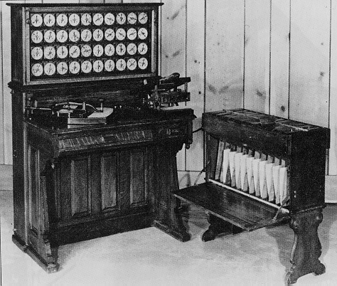
Hollerith’s Machine
In 1896 Hollerith founded the Tabulating Machine Company (TMC) to sell his invention. The company developed into International Business Machines (IBM) in the 1920s.
Hollerith’s 1890 Census Machine

Slide 29
Early 20th Century Computers
There were variations on mechanical and electro-mechanical computing devices. Transitory inventions. Consider:
Charles and Howard Krum’s Teleprinter
Vannevar Bush’s Differential Analyser
George Stibitz's Complex Number Calculator
Alan Turing’s (big contribution to Bletchley Park’s) Collossus

Slide 30
Electronic Numerical Integrator And Computer (ENIAC)
Ballistics Research Laboratory, started 1935, Maryland USA to scientifically support the military. Keeping tables on weapons’ firing tests was difficult. 3,000 trajectories for a typical table took 100 people one month.
200 people were employed with calculators.
Along comes World War 2, along comes government investment, along comes ENIAC from the University of Pennsylvania.

Slide 31
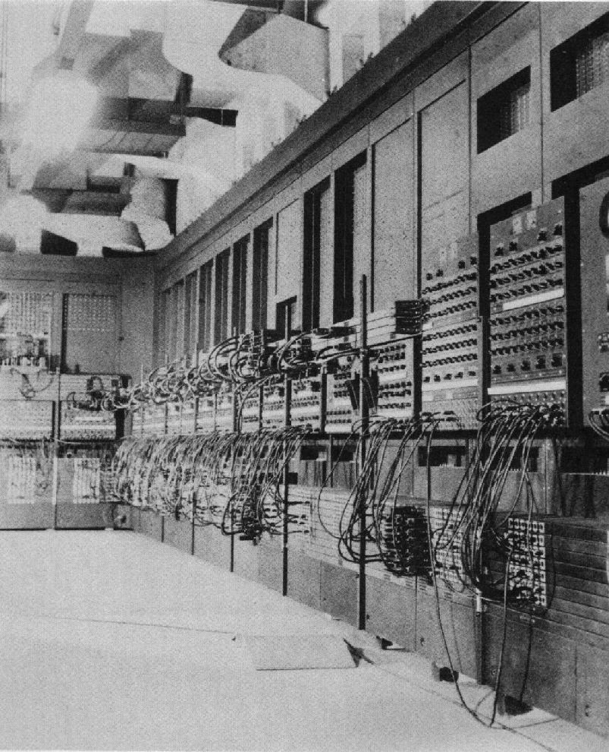
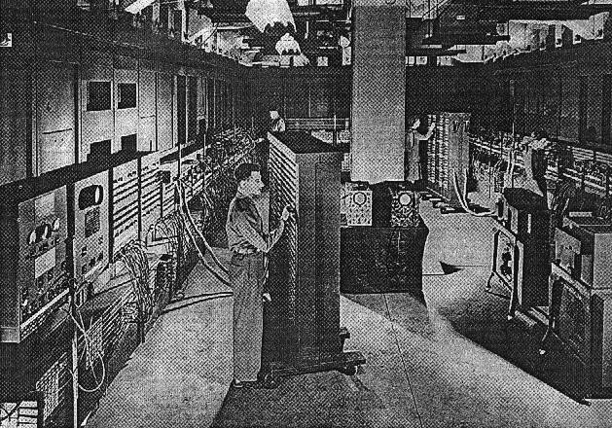
ENIAC (2)
ENIAC – (Electronic Numerical Integrator And Computer) is really the world's first electronic digital computer.

Slide 32
ENIAC (3)
ENIAC was developed by Dr. J. Presper Eckert and Dr. John W. Mauchly.
It filled an entire room, weighed thirty tons, and consumed two hundred kilowatts of power.
More than 19,000 vacuum tubes were the principal elements in the computer's circuitry. It also had fifteen hundred relays and hundreds of thousands of resistors, capacitors, and inductors.

Slide 33
EDVAC
EDVAC (Electronic Discrete Variable Automatic Computer) was Mauchly and Eckert’s next project – they started working on it two years before ENIAC even went into operation.
The program for the computer stored inside the computer, made possible by having more internal memory than any other computing device.
Memory used mercury delay lines. The idea being that given a tube of mercury, an electronic pulse could be bounced back and forth to be retrieved at will. Another two state device for storing 0s and 1s. This on/off switchability for memory was required because EDVAC used binary rather than decimal numbers, thus simplifying the construction of the arithmetic units.

Slide 34
Diversion
We need to divert from hardware history at this point, as Mauchly, Eckert and von Neumann developed a new idea on how vacuum tube-based hardware could handle instructions and data. (Around the mid-1940s)
This was a new architectural approach to systems.
Briefly, Systems Architecture History…

Slide 35
John Von Neumann
John Von Neumann wrote a paper called ‘The First Draft’ which described the stored program concept.
He was involved with the ENIAC and the EDVAC projects.
He became associated with ‘inventing’ modern programming in a kind of scientific community mistake. (The concept was really Eckert and Mauchly’s.)

Slide 36
EDVAC Layout
Arithmetic
Logic Unit
Main
I/O
Memory
Equipment
Program
Control Unit

Slide 37
EDSAC
Meanwhile… over in England… a machine called the Electronic Delay Storage Automatic Calculator (EDSAC) started running at Cambridge University on 6th May 1949. It was a project by Professor Maurice Wilkes.
EDSAC contained 3,000 vacuum tubes and used mercury delay lines for memory.
Programs were input using paper tape and output results appeared on a teleprinter.
EDSAC is credited as using one of the first assemblers (more on assemblers in another lecture) called "Initial Orders," so it could be programmed symbolically rather than using machine code.

Slide 38
EDSAC Specification
EDSAC had 512 words of 35 bits each of main RAM (Random Access Memory). (Total: just over 2 kilobytes.)
The RAM was made of 32 long tanks of mercury carrying ultrasonic sound pulses.
The system ran at a clock speed of 500kHz, but since the EDSAC was a serial computer, and because of the memory design, it managed about 600 instructions per second.
18 different instructions possible, each took 17 bits, or one half-word. Values could either be integers or fixed-point numbers (from -1 to 1), occupying either a whole 35-bit word or a 17-bit half-word.
The accumulator had a capacity of 71 bits.

Slide 39
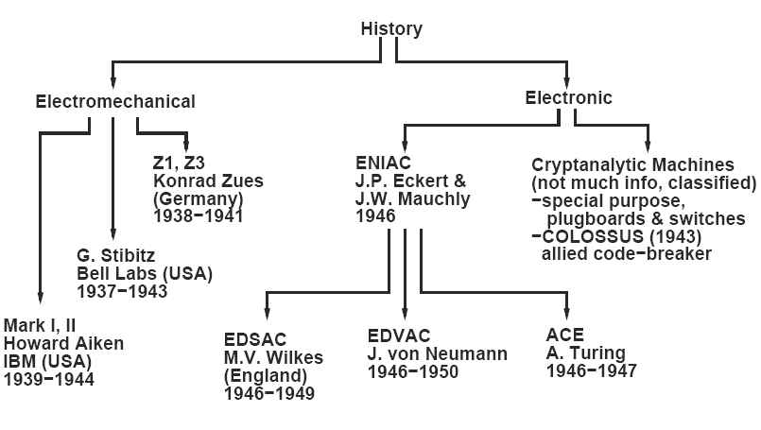
1935 – 1950 Summary

Slide 40
Back to Hardware History
Now we can go back to historic hardware – to pick up on the move away from vacuum tube technology and towards the alternatives that reduce the size of circuits and improve power efficiency…

Slide 41
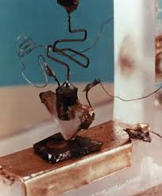
Transistors
Transistors are credited to John Bardeen, William Shockley, and Walter Brattain, scientists at the Bell Telephone Laboratories in New Jersey, U.S.A.
In the early 1950s they were researching the possibility of using crystals as semi-conductors - attempting to replace vacuum tubes as relays in telecommunications systems.
A very early Shockley, Bardeen, Brattain Transistor

Slide 42
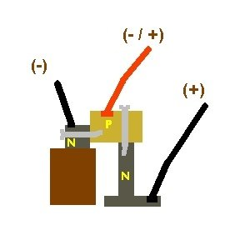
Transistors (2)
The transistor is a device composed of semi-conductor material that can both conduct and insulate. (Germanium and silicon can do that.)
Transistors switch and modulate electronic current.
The "point-contact" transistor amplifier.
-n emitter
p base
+n collector
Low voltage at base and emitter – higher voltage at collector and emitter

Slide 43
Integrated Circuits
From 1956 transistors revolutionised computer hardware. The research, at that time, was to reduce the wiring and soldered connections.
Jack St. Clair Kilby, an engineer with Texas Instruments, manufactured the first integrated circuit or ‘chip’ in 1958. Robert Noyce, research engineer and co-founder the Fairchild Semiconductor Corporation was also making progress on a chip.
With transistor-type circuits the transistors, resistors, capacitors and all the connecting wiring are separate. The monolithic - or single crystal - integrated circuit placed all components and most wiring onto a single, semiconducting crystal.
Kilby used germanium and Noyce used silicon as the basis of their respective chips.

Slide 44
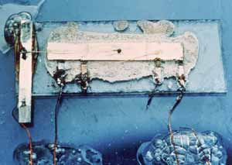
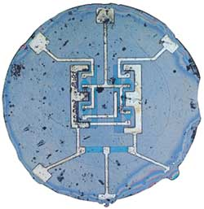
Integrated Circuits
Kilby and Noyce patented their devices separately but came to an agreement a few years after legal wrangling to allow both patents to act as one… Ker-ching!
The Kilby Integrated Circuit
The Noyce Integrated Circuit

Slide 45
Microprocessors
1968, Bob Noyce and Gordon Moore left ‘Fairchild’ and set up Intel. November 1971, Intel announced the world's first single chip microprocessor; the Intel 4004.
The 4004 was invented by Federico Faggin, Ted Hoff, and Stan Mazor, engineers at Intel.
This was more that just an integrated circuit - the Intel 4004 chip reduced the size requirements for a processor by placing the central processing unit, memory, input and output controls on one small chip.

Slide 46
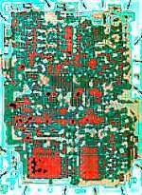
Microprocessors (2)
Layout for the Intel 4004

Slide 47
Multi Core Processors
Place two or more processor circuits on one IC (integrated circuit) – or two or more individual processors to work together - and you have a ‘multicore’ (or multi-core) architecture. A core is a collection of one or more processor threads with the components to execute instructions – such as Arithmetic Logic Unit, Cache, RAM…
(N.B. Multi core arrangements usually contain much more cache than regular processors.)

Slide 48
Multi Core Processors (2)
A thread (thread of execution) is ‘placeholder information’ associated with a single use of a program that can handle multiple concurrent users. A thread is like a task but is not actually an instruction task. Many ordinary, single-core processors can perform ‘multithreading’ - multiple threads are executed in parallel by ‘time slicing’ the processing capability of the processor and the processor can function by switching between different threads.

Slide 49
Multi Core Processors (3)
Multiple terms for multi-core:
‘Multi-core’ – more than one core
‘Dual-core’ – two CPU cores on one IC or two separate ICs
‘Multi-chip module’ – an alternative name for two or more separate ICs
‘Double core’ or ‘twin core’ - alternative names for two separate ICs
‘Quad-core’ – four CPU cores on one IC or two separate ICs

Slide 50
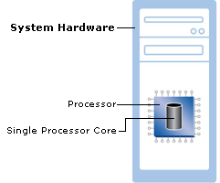
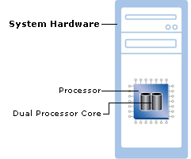
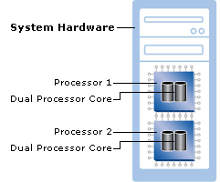
Multi Core Processors (4)
Microsoft’s multi-core diagrams:
1
2
3

Slide 51
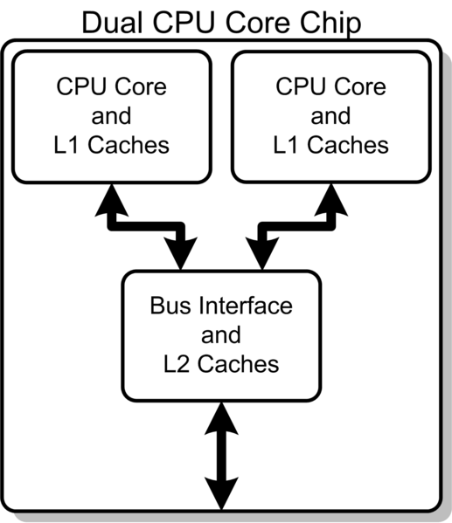
Multi Core Processors (5)
Dual core block diagram

Slide 52
Multi Core Processors - Summary
A dual core set-up is comparable to having multiple, separate processors installed in the same computer, but because the two processors are actually plugged into the same socket, the connection between them is faster. Ideally, a dual core processor is nearly twice as powerful as a single core processor. In practice, performance gains are about fifty percent: a dual core processor is about one-and-a-half times as powerful as a single core processor.

Slide 53
Back to Architecture, Briefly
We can go back to architecture to finish the lecture.
This is just to introduce the principle of computer architecture…

Slide 54
Introducing Architecture
Computer architecture can be a reference model, such as the Open Systems Interconnection (OSI) reference model, intended as a model for specific product architectures, or it can be a specific product architecture, such as that for an Intel microprocessor or for one of IBM's or Microsoft’s operating systems.

Slide 55
Introducing Architecture (2)
Architecture can be divided into five fundamental components:
input/output,
storage,
communication,
control,
processing.
In practice, each of these components (sometimes called subsystems) is sometimes said to have an architecture of its own.

Slide 56
Introducing Architecture (3)
By comparison, the term design might be considered as having less scope than architecture.
An architecture is a design, but most designs are not architectures. A single component or a new function has a design that has to fit within the overall architecture.
In hardware terms, the architecture is a very detailed description of every component – even the microscopic ones of the processor(s) – and their interaction.

Slide 57
Next Week…
… Electricity for Hardware.

